Slide 1

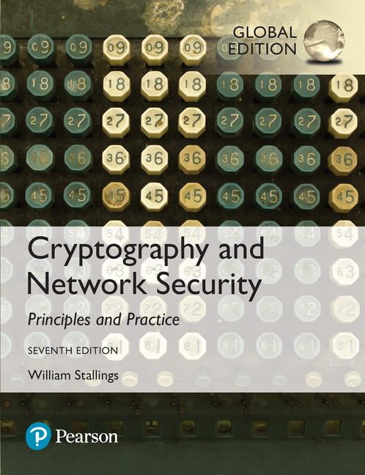
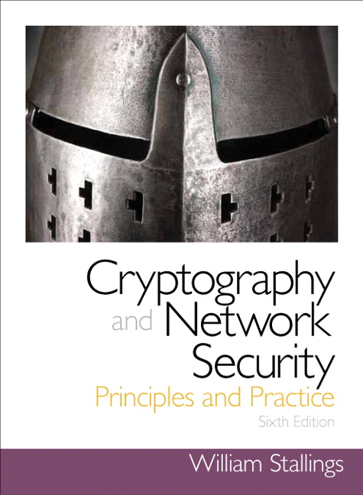
Cryptography and Network Security
Seventh Edition, Global Edition
by William Stallings
Notes:
Lecture slides prepared for “Cryptography and Network Security”, 7/e, by William Stallings, Chapter 8 – “Random Bit Generation and Stream Ciphers”.

Slide 2
Chapter 6
Stream Ciphers
Notes:
An important cryptographic function is the generation of random bit streams. Random
bits streams are used in a wide variety of contexts, including key generation and
encryption. In essence, there are two fundamentally different strategies for generating
random bits or random numbers. One strategy, which until recently dominated in cryptographic
applications, computes bits deterministically using an algorithm. This class of
random bit generators is known as pseudorandom number generators (PRNGs) or
deterministic random bit generators (DRBGs). The other strategy is to produce bits
non-deterministically using some physical source that produces some sort of random
output. This latter class of random bit generators is known as true random number
generators (TRNGs) or non-deterministic random bit generators (NRBGs).
The chapter begins with an analysis of the basic principles of PRNGs. Next, we
look at some common PRNGs, including PRNGs based on the use of a symmetric
block cipher. The chapter then moves on to the topic of symmetric stream ciphers,
which are based on the use of a PRNG. The chapter next examines the most important
stream cipher, RC4.
The remainder of the chapter is devoted to TRNGs. We look first at the basic
principles and structure of TRNGs, and then examine a specific product, the Intel
Digital Random Number Generator.
Throughout this chapter, reference is made to four important NIST documents:
■ SP 800-90A (Recommendation for Random Number Generation Using
Deterministic Random Bit Generators, January 2012) covers DRNGs.
■ SP 800-90B (Recommendation for the Entropy Sources Used for Random Bit
Generation, August 2012) covers criteria for entropy sources (ES), the devices
from which we get unpredictable randomness and NRNGs.
■ SP 800-90C (Recommendation for Random Bit Generator (RBG)
Constructions, August 2012) discusses how to combine the entropy sources in
90B with the DRNG’s from 90A to provide large quantities of unpredictable
bits for cryptographic applications.
■ SP 800-22 (A Statistical Test Suite for Random and Pseudorandom Number
Generators for Cryptographic Applications, April 2010) discusses the selection
and testing of NRBGs and DRBGs.
These specifications have heavily influenced the implementation of random bit
generators in industry both in the U.S. and worldwide.

Slide 3
Types of Ciphers
Cryptography
Classical
Modern (Key-based)
Symmetric
Asymmetric
Hash Function
Block
Stream
RSA
Diffie-Hellman
MD5
SHA
DES
AES
RC4

Slide 4
Random Numbers
A number of network security algorithms and protocols based on cryptography make use of random binary numbers:
Key distribution and authentication schemes
Session key generation
Generation of keys for the RSA public-key encryption algorithm
Generation of a bit stream for symmetric stream encryption
There are two distinct requirements for a sequence of random numbers:
Randomness
Unpredictability
Notes:
A number of network security algorithms and protocols based on cryptography
make use of random binary numbers. For example,
• Key distribution and reciprocal (mutual) authentication schemes, such as
those discussed in Chapters 14 and 15. In such schemes, two communicating
parties cooperate by exchanging messages to distribute keys and/or authenticate
each other. In many cases, nonces are used for handshaking to prevent
replay attacks. The use of random numbers for the nonces frustrates an opponent’s
efforts to determine or guess the nonce, in order to repeat an obsolete
transaction.
• Session key generation. We will see a number of protocols in this book where
a secret key for symmetric encryption is generated for use for a particular
transaction (or session) and is valid for a short period of time. This key is
generally called a session key.
• Generation of keys for the RSA public-key encryption algorithm (described
in Chapter 9).
• Generation of a bit stream for symmetric stream encryption (described in this
chapter).
These applications give rise to two distinct and not necessarily compatible
requirements for a sequence of random numbers: randomness and unpredictability.

Slide 5
Randomness
The generated bit stream needs to appear random even though it is deterministic
Two criteria are used to validate that a sequence of numbers is random:
Uniform distribution
The frequency of occurrence of ones and zeros should be approximately equal
Independence
No one subsequence in the sequence can be inferred from the others
Notes:
Traditionally, the concern in the generation of a sequence of allegedly
random numbers has been that the sequence of numbers be random in some
well-defined statistical sense. The following two criteria are used to validate that a
sequence of numbers is random:
• Uniform distribution: The distribution of bits in the sequence should be uniform;
that is, the frequency of occurrence of ones and zeros should be approximately
equal.
• Independence: No one subsequence in the sequence can be inferred from the
others.
Although there are well-defined tests for determining that a sequence of bits
matches a particular distribution, such as the uniform distribution, there is no such
test to “prove” independence. Rather, a number of tests can be applied to demonstrate
if a sequence does not exhibit independence. The general strategy is to apply
a number of such tests until the confidence that independence exists is sufficiently
strong. That is, if each of a number of tests fails to show that a sequence of bits is
not independent, then we can have a high level of confidence that the sequence is in
fact independent.

Slide 6
Unpredictability
The requirement is not just that the sequence of numbers be statistically random, but that the sequential members of the sequence are unpredictable
With “true” random sequences each number is statistically independent of other numbers in the sequence and therefore unpredictable
Care must be taken that an opponent not be able to predict future elements of the sequence on the basis of earlier elements
Notes:
In applications such as reciprocal authentication, session key
generation, and stream ciphers, the requirement is not just that the sequence of
numbers be statistically random but that the successive members of the sequence
are unpredictable. With “true” random sequences, each number is statistically independent
of other numbers in the sequence and therefore unpredictable. Although
true random numbers are used in some applications, they have their limitations,
such as inefficiency, as is discussed shortly. Thus, it is more common to implement
algorithms that generate sequences of numbers that appear to be random. In this
latter case, care must be taken that an opponent not be able to predict future elements
of the sequence on the basis of earlier elements.

Slide 7
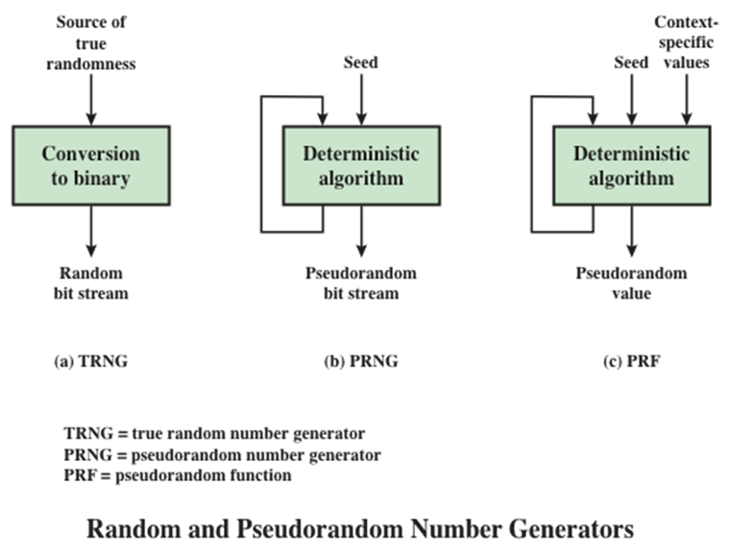
Notes:
Figure 8.1 contrasts a true random number generator (TRNG) with two forms
of pseudorandom number generators.

Slide 8
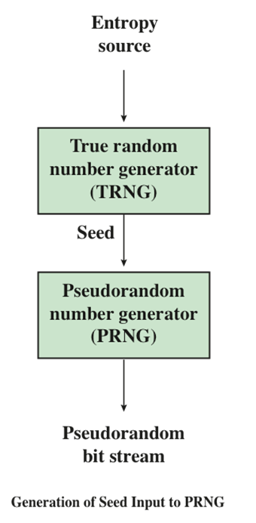
Generation of Seed Input to PRNG
Notes:
Typically, the seed is generated by a TRNG, as shown in Figure 7.2. This is the
scheme recommended by SP800-90. The reader may wonder, if a TRNG is available,
why it is necessary to use a PRNG. If the application is a stream cipher, then
a TRNG is not practical. The sender would need to generate a keystream of bits as
long as the plaintext and then transmit the keystream and the ciphertext securely to
the receiver. If a PRNG is used, the sender need only find a way to deliver the stream
cipher key, which is typically 54 or 128 bits, to the receiver in a secure fashion.
Even in the case of a PRF application, in which only a limited number of bits
is generated, it is generally desirable to use a TRNG to provide the seed to the
PRF and use the PRF output rather than use the TRNG directly. As is explained
in Section 7.6, a TRNG may produce a binary string with some bias. The PRF
would have the effect of “randomizing” the output of the TRNG so as to eliminate
that bias.
Finally, the mechanism used to generate true random numbers may not be
able to generate bits at a rate sufficient to keep up with the application requiring
the random bits.

Slide 9
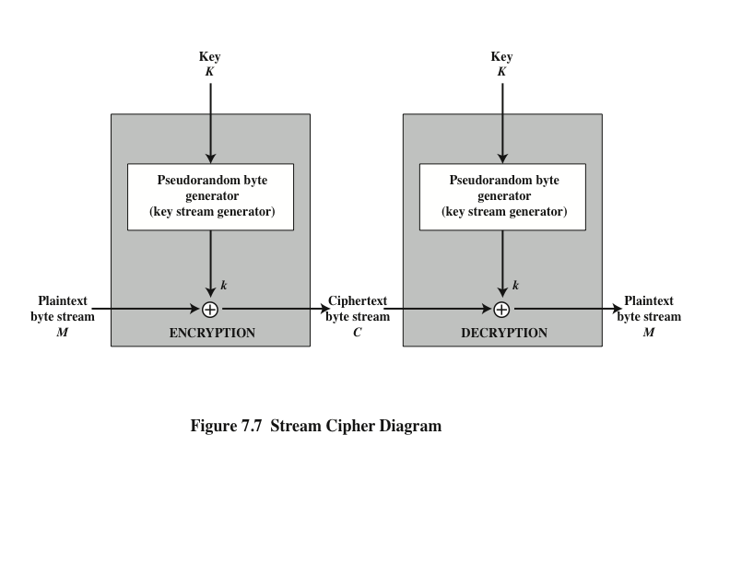
Stream Ciphers
Notes:
A typical stream cipher encrypts plaintext one byte at a time, although a stream
cipher may be designed to operate on one bit at a time or on units larger than a byte
at a time. Figure 7.7 is a representative diagram of stream cipher structure. In this
structure, a key is input to a pseudorandom bit generator that produces a stream
of 8-bit numbers that are apparently random. The output of the generator, called
a keystream , is combined one byte at a time with the plaintext stream using the
bitwise exclusive-OR (XOR) operation.

Slide 10
Stream Cipher Design Considerations
The encryption sequence should have a large period
A pseudorandom number generator uses a function that produces a deterministic stream of bits that eventually repeats; the longer the period of repeat the more difficult it will be to do cryptanalysis
The keystream should approximate the properties of a true random number stream as close as possible
There should be an approximately equal number of 1s and 0s
If the keystream is treated as a stream of bytes, then all of the 256 possible byte values should appear approximately equally often
A key length of at least 128 bits is desirable
The output of the pseudorandom number generator is conditioned on the value of the input key
The same considerations that apply to block ciphers are valid
With a properly designed pseudorandom number generator, a stream cipher can be as secure as a block cipher of comparable key length
A potential advantage is that stream ciphers that do not use block ciphers as a building block are typically faster and use far less code than block ciphers
Notes:
The stream cipher is similar to the one-time pad discussed in Chapter 2. The
difference is that a one-time pad uses a genuine random number stream, whereas a
stream cipher uses a pseudorandom number stream.
[KUMA97] lists the following important design considerations for a stream cipher.
1. The encryption sequence should have a large period. A pseudorandom number
generator uses a function that produces a deterministic stream of bits that
eventually repeats. The longer the period of repeat the more difficult it will
be to do cryptanalysis. This is essentially the same consideration that was discussed
with reference to the Vigenère cipher, namely that the longer the keyword
the more difficult the cryptanalysis.
2. The keystream should approximate the properties of a true random number
stream as close as possible. For example, there should be an approximately
equal number of 1s and 0s. If the keystream is treated as a stream of bytes,
then all of the 256 possible byte values should appear approximately equally
often. The more random-appearing the keystream is, the more randomized the
ciphertext is, making cryptanalysis more difficult.
3. Note from Figure 7.7 that the output of the pseudorandom number generator
is conditioned on the value of the input key. To guard against brute-force
attacks, the key needs to be sufficiently long. The same considerations that
apply to block ciphers are valid here. Thus, with current technology, a key
length of at least 128 bits is desirable.
With a properly designed pseudorandom number generator, a stream cipher
can be as secure as a block cipher of comparable key length. A potential advantage
of a stream cipher is that stream ciphers that do not use block ciphers as a building
block are typically faster and use far less code than do block ciphers. The example
in this chapter, RC4, can be implemented in just a few lines of code. In recent years,
this advantage has diminished with the introduction of AES, which is quite efficient
in software. Furthermore, hardware acceleration techniques are now available for
AES. For example, the Intel AES Instruction Set has machine instructions for one
round of encryption and decryption and key generation. Using the hardware instructions
results in speedups of about an order of magnitude compared to pure
software implementations [XU10].
One advantage of a block cipher is that you can reuse keys. In contrast, if two
plaintexts are encrypted with the same key using a stream cipher, then cryptanalysis
is often quite simple [DAWS96]. If the two ciphertext streams are XORed together,
the result is the XOR of the original plaintexts. If the plaintexts are text strings,
credit card numbers, or other byte streams with known properties, then cryptanalysis
may be successful.
For applications that require encryption/decryption of a stream of data, such as
over a data communications channel or a browser/Web link, a stream cipher might
be the better alternative. For applications that deal with blocks of data, such as file
transfer, e-mail, and database, block ciphers may be more appropriate. However,
either type of cipher can be used in virtually any application.
A stream cipher can be constructed with any cryptographically strong PRNG,
such as the ones discussed in Sections 7.2 and 7.3. In the next section, we look at a
stream cipher that uses a PRNG designed specifically for the stream cipher.

Slide 11
RC4
Designed in 1987 by Ron Rivest for RSA Security
Variable key size stream cipher with byte-oriented operations
Based on the use of a random permutation
Eight to sixteen machine operations are required per output byte and the cipher can be expected to run very quickly in software
Used in the Secure Sockets Layer/Transport Layer Security (SSL/TLS) standards that have been defined for communication between Web browsers and servers
Is also used in the Wired Equivalent Privacy (WEP) protocol and the newer WiFi Protected Access (WPA) protocol that are part of the IEEE 802.11 wireless LAN standard
Notes:
RC4 is a stream cipher designed in 1987 by Ron Rivest for RSA Security. It is a variable
key size stream cipher with byte-oriented operations. The algorithm is based
on the use of a random permutation. Analysis shows that the period of the cipher
is overwhelmingly likely to be greater than 10¹⁰⁰ [ROBS95a]. Eight to sixteen machine
operations are required per output byte, and the cipher can be expected to
run very quickly in software. RC4 is used in the Secure Sockets Layer/Transport
Layer Security (SSL/TLS) standards that have been defined for communication between
Web browsers and servers. It is also used in the Wired Equivalent Privacy
(WEP) protocol and the newer WiFi Protected Access (WPA) protocol that are
part of the IEEE 802.11 wireless LAN standard. RC4 was kept as a trade secret by
RSA Security. In September 1994, the RC4 algorithm was anonymously posted on
the Internet on the Cypherpunks anonymous remailers list.
The RC4 algorithm is remarkably simple and quite easy to explain. A variable-length
key of from 1 to 256 bytes (8 to 2048 bits) is used to initialize a 256-byte state
vector S, with elements S[0], S[1], c , S[255]. At all times, S contains a permutation
of all 8-bit numbers from 0 through 255. For encryption and decryption, a byte k (see
Figure 7.7) is generated from S by selecting one of the 255 entries in a systematic
fashion. As each value of k is generated, the entries in S are once again permuted.

Slide 12
Strength of RC4
A number of papers have been published analyzing methods of attacking RC4
None of these approaches is practical against RC4 with a reasonable key length
A more serious problem is that the WEP protocol intended to provide confidentiality on 802.11 wireless LAN networks is vulnerable to a particular attack approach
The problem is not with RC4 itself, but the way in which keys are generated for use as input
Problem does not appear to be relevant to other applications and can be remedied in WEP by changing the way in which keys are generated
Problem points out the difficulty in designing a secure system that involves both cryptographic functions and protocols that make use of them
Notes:
A number of papers have been published analyzing methods of attacking RC4
(e.g., [KNUD98], [FLUH00], [MANT01]). None of these approaches is practical
against RC4 with a reasonable key length, such as 128 bits. A more serious problem
is reported in [FLUH01]. The authors demonstrate that the WEP protocol,
intended to provide confidentiality on 802.11 wireless LAN networks, is vulnerable
to a particular attack approach. In essence, the problem is not with RC4 itself
but the way in which keys are generated for use as input to RC4. This particular
problem does not appear to be relevant to other applications using RC4 and can be
remedied in WEP by changing the way in which keys are generated. This problem
points out the difficulty in designing a secure system that involves both cryptographic
functions and protocols that make use of them.

Slide 13
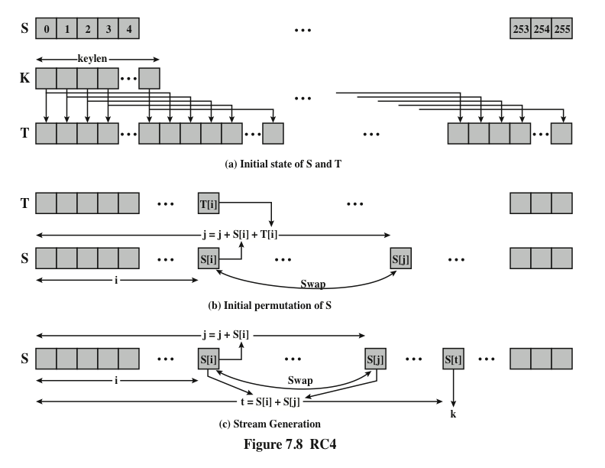
Notes:
Figure 7.8 illustrates the RC4 logic.

Slide 14
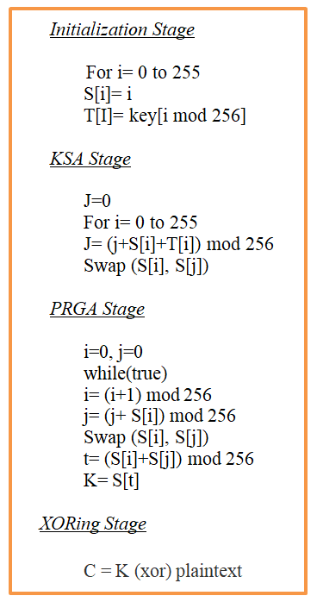
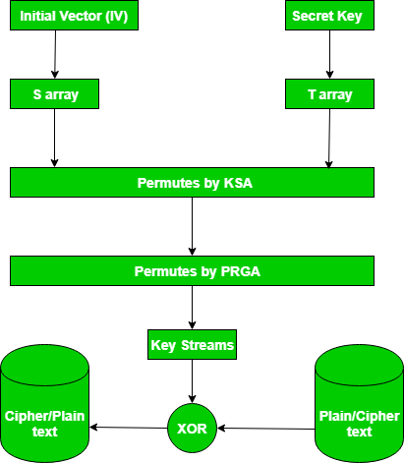
Notes:
KSA: Key-Generation Algorithm
PRGA: Pseudo random generation algorithm (Stream Generation)

Slide 15
Simplified RC4 Example
Lets consider the stream cipher RC4, but instead of the full 256 bytes, we will use 8 x 3-bits.
That is, the state vector S is 8 x 3-bits (i.e., S can take the values 0 to 7).
Assume we use a 4 x 3-bit key of K = [1 2 3 6]. And a plaintext P = [1 2 2 2]

Slide 16
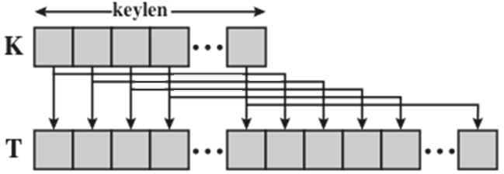
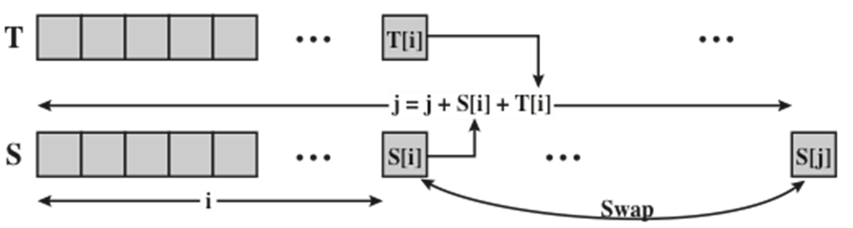
Simplified RC4 Example
Step 1: initial state of S and T
S = [0 1 2 3 4 5 6 7]
T = [1 2 3 6 1 2 3 6]
Step 2: perform the initial permutation on S.
j = 0;
for i = 0 to 7 do
j = (j + S[i] + T[i]) mod 8
Swap(S[i],S[j]);
end

Slide 17
Simplified RC4 Example
T = [1 2 3 6 1 2 3 6]
i = 0:
j = (j + s[0] + T[0]) mod 8 = (0 + 0 + 1) mod 8 = 1
Swap(S[0],S[1]);
S = [1 0 2 3 4 5 6 7]
i = 1:
j = (j + s[1]+T[1]) mod 8= 1+0+2=3
Swap(S[1],S[3])
S = [1 3 2 0 4 5 6 7]

Slide 18
Simplified RC4 Example
T = [1 2 3 6 1 2 3 6]
i = 2:
j = (3+S[2]+T[2])mod 8= (3+2+3)mod 8= 0
Swap(S[2],S[0])
S = [2 3 1 0 4 5 6 7]
i = 3:
j = (0+S[3]+T[3])mod 8= (0+0+6)mod 8= 6
Swap(S[3],S[6])
S = [2 3 1 6 4 5 0 7]y
… etc.

Slide 19
Simplified RC4 Example
S = [0 1 2 3 4 5 6 7] T = [1 2 3 6 1 2 3 6]
i | S[i] | T[i] | j | S[j] | S after Swapping
0 | 0 | 1 | 1 | 1 | [1 0 2 3 4 5 6 7]

Slide 20
Simplified RC4 Example
T = [1 2 3 6 1 2 3 6]
i | S[i] | T[i] | j | S[j] | S after Swapping
0 | 0 | 1 | 1 | 1 | [1 0 2 3 4 5 6 7]
1 | 0 | 2 | 3

Slide 21
Simplified RC4 Example
T = [1 2 3 6 1 2 3 6]
i | S[i] | T[i] | j | S[j] | S after Swapping
0 | 0 | 1 | 1 | 1 | [1 0 2 3 4 5 6 7]
1 | 0 | 2 | 3 | 3 | [1 3 2 0 4 5 6 7]

Slide 22
Simplified RC4 Example
T = [1 2 3 6 1 2 3 6]
i | S[i] | T[i] | j | S[j] | S after Swapping
0 | 0 | 1 | 1 | 1 | [1 0 2 3 4 5 6 7]
1 | 0 | 2 | 3 | 3 | [1 3 2 0 4 5 6 7]
2 | 2 | 3 | 0 | 1 | [2 3 1 0 4 5 6 7]

Slide 23
Simplified RC4 Example
T = [1 2 3 6 1 2 3 6]
i | S[i] | T[i] | j | S[j] | S after Swapping
0 | 0 | 1 | 1 | 1 | [1 0 2 3 4 5 6 7]
1 | 0 | 2 | 3 | 3 | [1 3 2 0 4 5 6 7]
2 | 2 | 3 | 0 | 1 | [2 3 1 0 4 5 6 7]
3 | 0 | 6 | 6 | 6 | [2 3 1 6 4 5 0 7]

Slide 24
Simplified RC4 Example
T = [1 2 3 6 1 2 3 6]
i | S[i] | T[i] | j | S[j] | S after Swapping
0 | 0 | 1 | 1 | 1 | [1 0 2 3 4 5 6 7]
1 | 0 | 2 | 3 | 3 | [1 3 2 0 4 5 6 7]
2 | 2 | 3 | 0 | 1 | [2 3 1 0 4 5 6 7]
3 | 0 | 6 | 6 | 6 | [2 3 1 6 4 5 0 7]
4 | 4 | 1 | 3 | 6 | [2 3 1 4 6 5 0 7]

Slide 25
Simplified RC4 Example
T = [1 2 3 6 1 2 3 6]
i | S[i] | T[i] | j | S[j] | S after Swapping
0 | 0 | 1 | 1 | 1 | [1 0 2 3 4 5 6 7]
1 | 0 | 2 | 3 | 3 | [1 3 2 0 4 5 6 7]
2 | 2 | 3 | 0 | 1 | [2 3 1 0 4 5 6 7]
3 | 0 | 6 | 6 | 6 | [2 3 1 6 4 5 0 7]
4 | 4 | 1 | 3 | 6 | [2 3 1 4 6 5 0 7]
5 | 5 | 2 | 2 | 1 | [2 3 5 4 6 1 0 7]
6 | 0 | 3 | 5 | 1 | [2 3 5 4 6 0 1 7]
7 | 7 | 6 | 2 | 5 | [2 3 7 4 6 0 1 5]

Slide 26
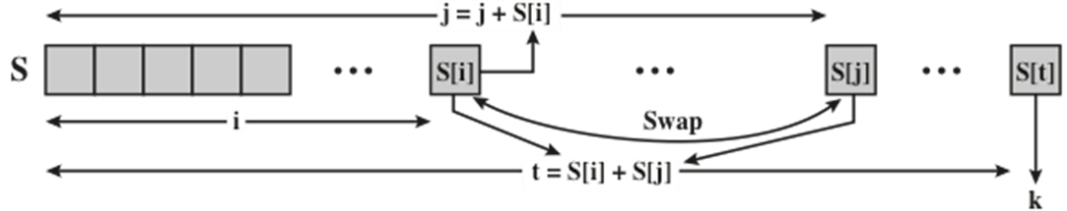
Simplified RC4 Example
The initial permutation of S = [2 3 7 4 6 0 1 5]
Step 3: Perform stream generation. The 3-bits k is generated by:
i, j = 0;
For 1 to PT.length {
i = (i + 1) mod 8;
j = (j + S[i]) mod 8;
Swap (S[i], S[j]);
t = (S[i] + S[j]) mod 8;
k = S[t];
}

Slide 27
Simplified RC4 Example
P = [1 2 2 2]
The first iteration:
S = [2 3 7 4 6 0 1 5]
i = (0 + 1) mod 8 = 1
j = (0 + S[1]) mod 8 = 3
t = (S[1] + S[3]) mod 8 = 7
Swap(S[1],S[3])
S = [2 4 7 3 6 0 1 5]
k1 = S[7] = 5
So the first 3-bits of ciphertext is obtained by:
k XOR P = 5 XOR 1 = 101 XOR 001 = 100 = 4

Slide 28
Simplified RC4 Example
S = [2 3 7 4 6 0 1 5]
i | S[i] | j | S[j] | t | Swap | K=S[t]
1 | 3 | 3 | 4 | 7 | [2 4 7 3 6 0 1 5] | 5

Slide 29
Simplified RC4 Example
i | S[i] | j | S[j] | t | Swap | K=S[t]
1 | 3 | 3 | 4 | 7 | [2 4 7 3 6 0 1 5] | 5
2 | 7 | 2 | 7 | 6 | [2 4 7 3 6 0 1 5] | 1

Slide 30
Simplified RC4 Example
i | S[i] | j | S[j] | t | Swap | K=S[t]
1 | 3 | 3 | 4 | 7 | [2 4 7 3 6 0 1 5] | 5
2 | 7 | 2 | 7 | 6 | [2 4 7 3 6 0 1 5] | 1
3 | 3 | 5 | 0 | 3 | [2 4 7 0 6 3 1 5] | 0

Slide 31
Simplified RC4 Example
i | S[i] | j | S[j] | t | Swap | KS=S[t]
1 | 3 | 3 | 4 | 7 | [2 4 7 3 6 0 1 5] | 5
2 | 7 | 2 | 7 | 6 | [2 4 7 3 6 0 1 5] | 1
3 | 3 | 5 | 0 | 3 | [2 4 7 0 6 3 1 5] | 0
4 | 6 | 3 | 0 | 6 | [2 4 7 6 0 3 1 5] | 1
Key stream (KS) =[5 1 0 1]

Slide 32
Simplified RC4 Example
So to encrypt the plaintext stream
P = [1 2 2 2] with key K = [1 2 3 6] using s-RC4 stream cipher we get:
P = [1 2 2 2]= [001 010 010 010]
KS=[5 1 0 1]= [ 101 001 000 001]
-----------------------------------------------------------------
C = P ⊕KS= [100 011 010 011]
Ciphertext= [ 4 3 2 3]

Slide 33
Simplified RC4 Example
Decryption= C ⊕ K
C = [4 3 2 3]= [100 011 010 011 ]
KS= [5 1 0 1]= [ 101 001 000 001]
-----------------------------------------------------------------
P = [001 010 010 010]
P = [ 1 2 2 2 ]

Slide 34
Summary
Principles of pseudorandom number generation
The use of random numbers
TRNGs, PRNGs, and PRFs
PRNG requirements
Algorithm design
Pseudorandom number generators
Linear congruential generators
Pseudorandom number generation using a block cipher
PRNG using block cipher modes of operation
ANSI X9.17 PRNG
NIST CTR_DRBG
Stream ciphers
RC4
Initialization of S
Stream generation
Strength of RC4
Notes:
Chapter 8 summary.

